Slide 1
Stronger Mixed-Size Placement Backbone Considering Second-Order Information
Yifan Chen, Zaiwen Wen, Yun Liang, Yibo Lin
Peking University, China
Presenter : Min-Feng Hsieh
Adviser : Ting-Chi Wang

Slide 2
Outline
Abstract
Introduction
Preliminaries
Proposed Algorithm
Congestion Estimation
Cell Padding
Strategy Exploration
Legalization
Experimental Result

Slide 3
Introduction
Macro placement significantly effects the eventual quality of the placement result.
Existing analytical placement algorithm may fail if the parameter is not well-tuned.
Some mixed-size placement algorithms leverage mathematical optimization.
mPL6, NTUplace, ePlace-MS
Some research focuses on efficient data structures to represent a macro placement.
CG, MP-tree, CP-tree

Slide 4
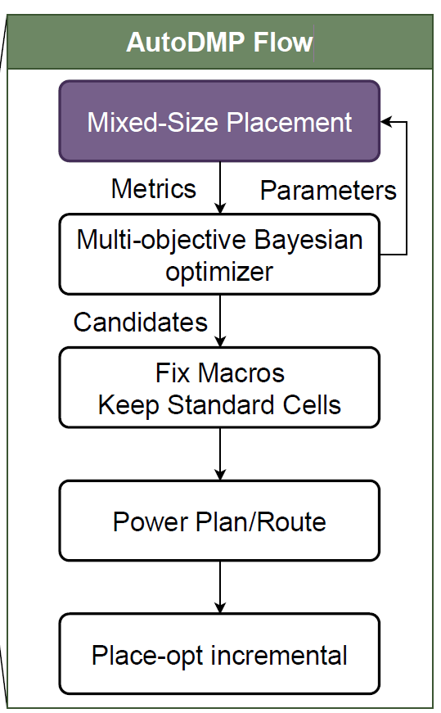
Introduction
Some machine learning techniques have also been proposed.
Macro placement solutions based on routability prediction.
Graph learning based initialization for mixed-size placement.
Reinforcement learning for macro refinement.
AutoDMP apply DREAMPlace to performs hyper-parameter searching upon a mixed-size placement.
Considering the congestion and the WL.

Slide 5
Introduction
The macros’ motion will cause drastic changes in the gradient due to their heterogeneous sizes.
Most mixed-size placement algorithms rely on first-order gradient information
They aim to address the convergence issue by considering second-order

Slide 6
Outline
Abstract
Introduction
Preliminaries
Proposed Algorithm
Congestion Estimation
Cell Padding
Strategy Exploration
Legalization
Experimental Result

Slide 7
Analytical Mixed-Size Placement
Including three stages:
Global placement
Legalization
Detail placement
Notes:
GR: 將instance分散到layout中
Legalization: 將instance中的overlap消除並且進行alignment
DR: further improve the quality

Slide 8
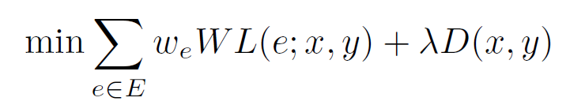
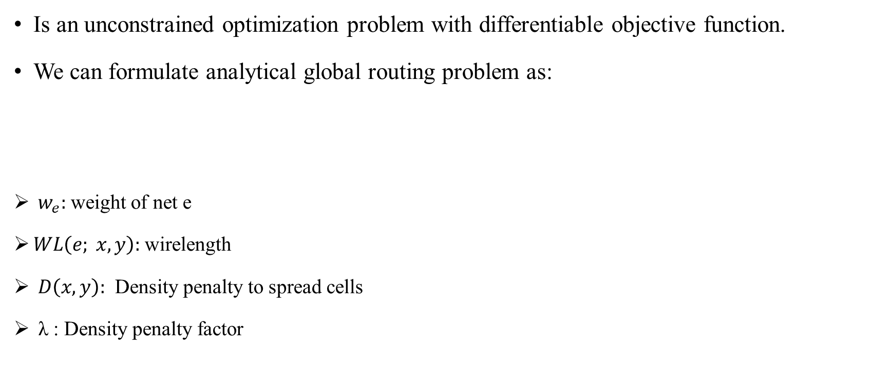
Analytical Mixed-Size Placement
Is an unconstrained optimization problem with differentiable objective function.
We can formulate analytical global routing problem as:
${ w}_{e}:$ weight of net e
$WL\left(e; x, y\right):$wirelength
$D\left(x, y\right):$ Density penalty to spread cells
λ : Density penalty factor

Slide 9
Macro Legalization
Legalization stage will ensure non-overlapping with minimum displacement.
The legalization will be divided into two parts:
Macro legalization
Instance legalization
Mainly focus on macro legalization in this paper.

Slide 10
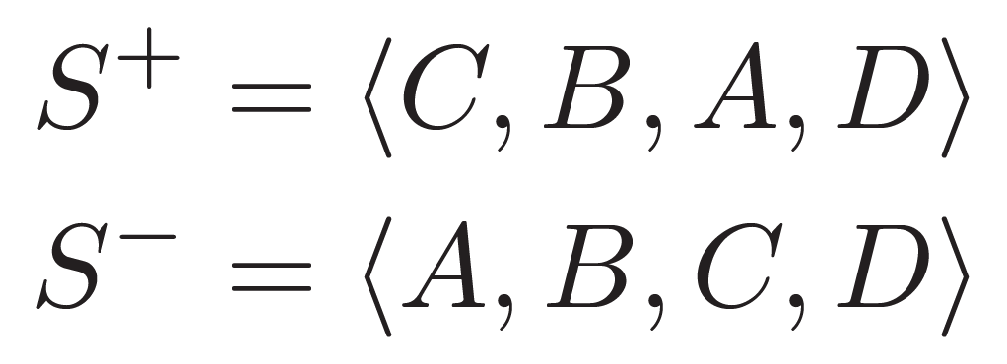
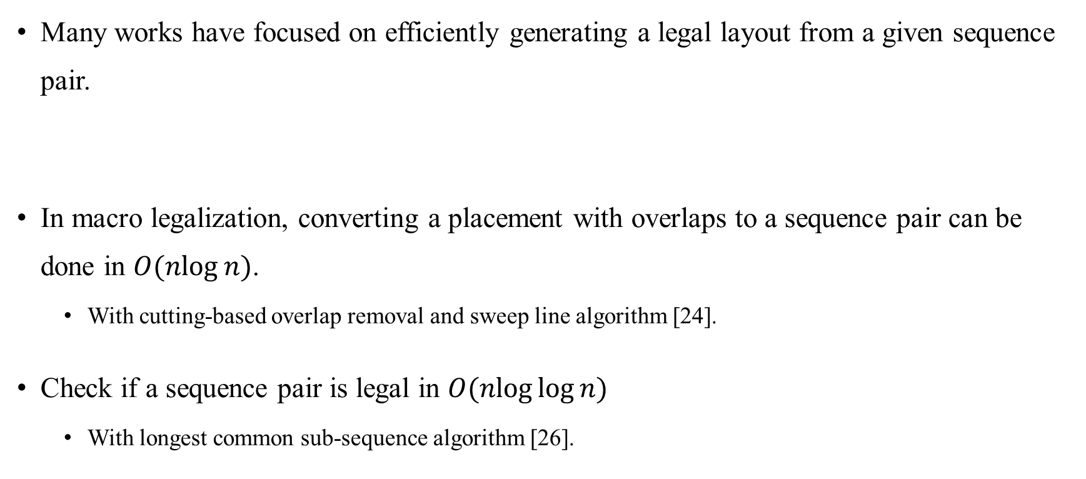
Sequence Pair
Many works have focused on efficiently generating a legal layout from a given sequence pair.
In macro legalization, converting a placement with overlaps to a sequence pair can be done in $O(nlog⁡n)$.
With cutting-based overlap removal and sweep line algorithm [24].
Check if a sequence pair is legal in $O(nlog⁡log⁡n)$
With longest common sub-sequence algorithm [26].

Slide 11
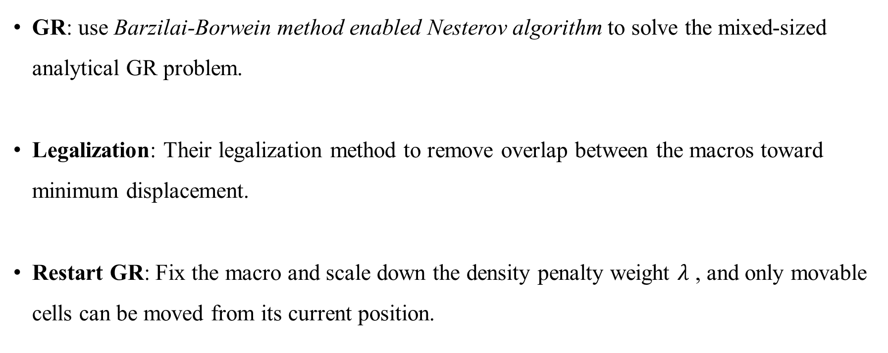
Algorithm
GR: use Barzilai-Borwein method enabled Nesterov algorithm to solve the mixed-sized analytical GR problem.
Legalization: Their legalization method to remove overlap between the macros toward minimum displacement.
Restart GR: Fix the macro and scale down the density penalty weight $λ$ , and only movable cells can be moved from its current position.

Slide 12
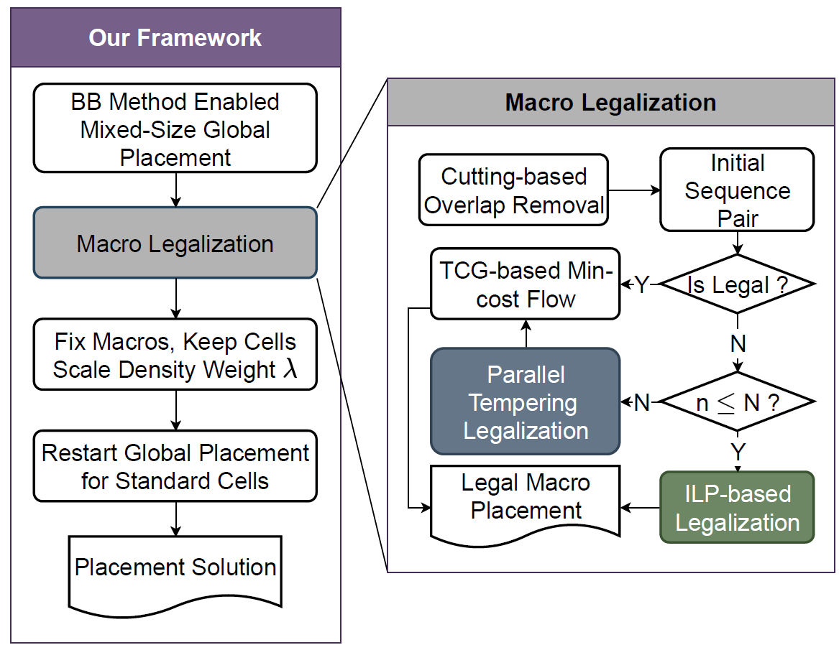
Algorithm

Slide 13
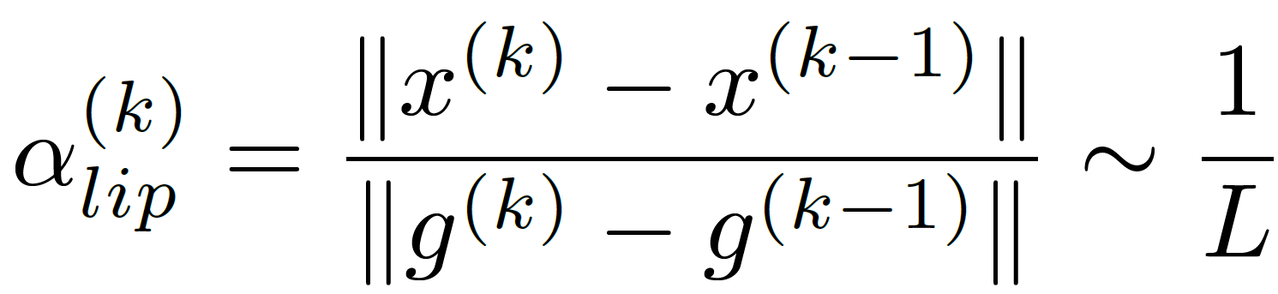
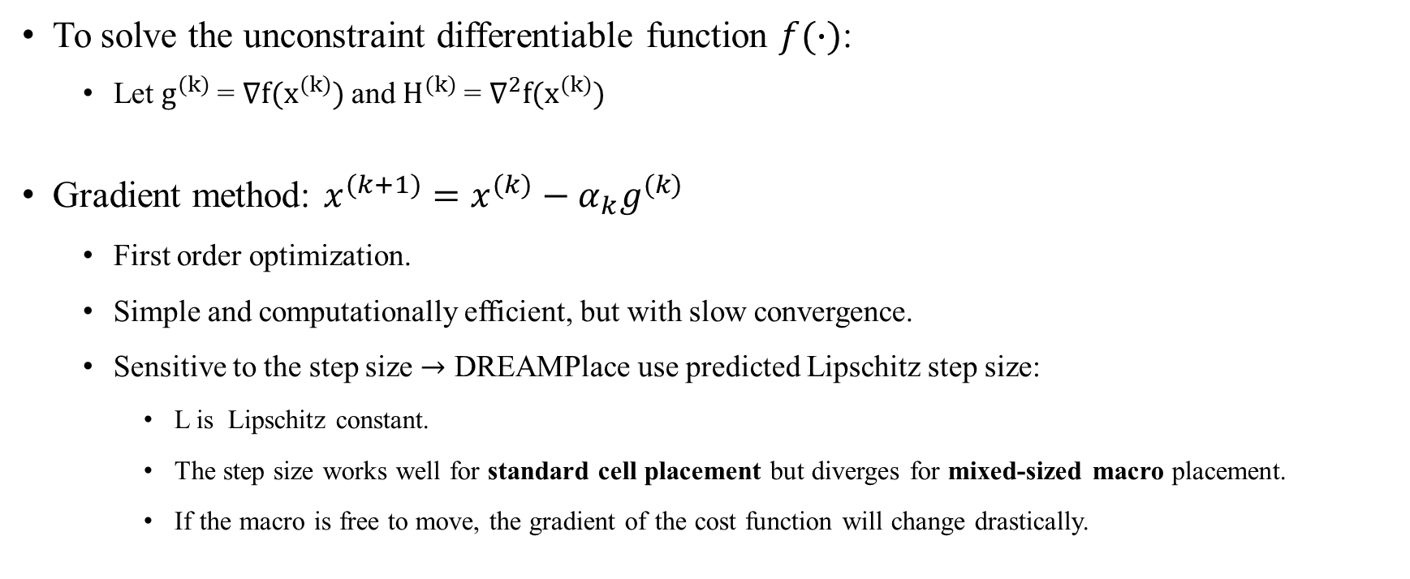
Gradient method
To solve the unconstraint differentiable function $f(∙)$:
Let $g^{(k)}$= $∇f(x^{(k)})$and $H^{(k)}$= $∇^{2}f(x^{(k)})$
Gradient method: $x^{(k+1)}=x^{(k)}−α_{k}g^{(k)}$
First order optimization.
Simple and computationally efficient, but with slow convergence.
Sensitive to the step size $→$ DREAMPlace use predicted Lipschitz step size:
L is Lipschitz constant.
The step size works well for standard cell placement but diverges for mixed-sized macro placement.
If the macro is free to move, the gradient of the cost function will change drastically.

Slide 14
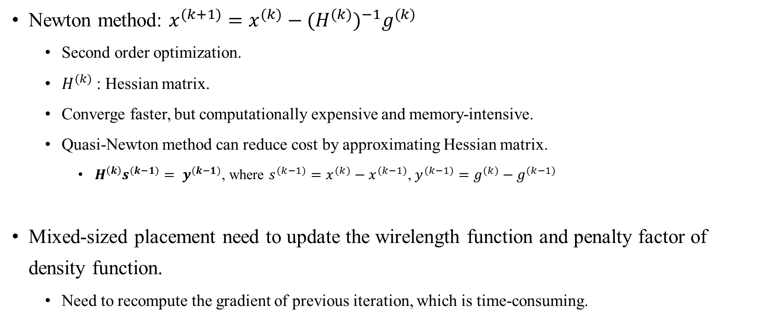
Newton method
Newton method: $x^{(k+1)}=x^{(k)}−{{(H}^{(k)})}^{−1}g^{(k)}$
Second order optimization.
$H^{(k)}$: Hessian matrix.
Converge faster, but computationally expensive and memory-intensive.
Quasi-Newton method can reduce cost by approximating Hessian matrix.
$H^{\left(k\right)}s^{(k−1)}= y^{(k−1)}$, where $s^{(k−1)}=x^{(k)}−x^{(k−1)}$, $y^{(k−1)}=g^{(k)}−g^{(k−1)}$
Mixed-sized placement need to update the wirelength function and penalty factor of density function.
Need to recompute the gradient of previous iteration, which is time-consuming.
Notes:
* 用weight或是log-sum-exp

Slide 15
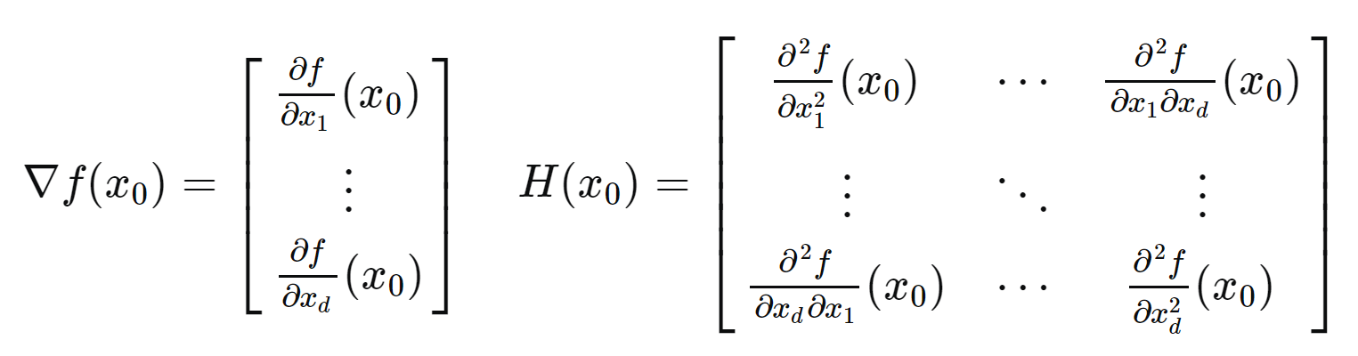

Slide 16
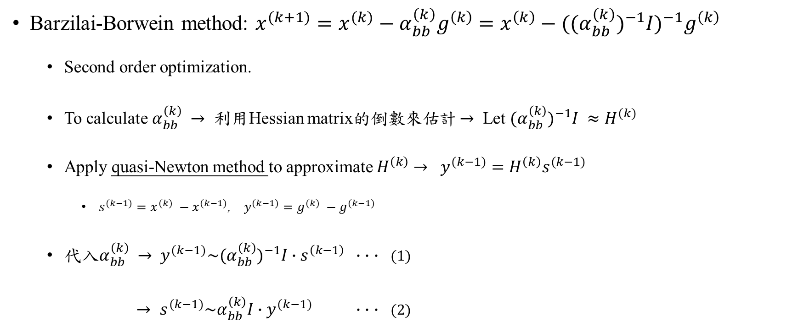
Barzilai-Borwein Method Enabled Nesterov Algorithm
Barzilai-Borwein method: $x^{(k+1)}=x^{(k)}−α_{bb}^{\left(k\right)}g^{\left(k\right)}=x^{\left(k\right)}−{((α}_{bb}^{\left(k\right)})^{−1}I)^{−1}g^{\left(k\right)}$
Second order optimization.
To calculate $α_{bb}^{\left(k\right)} →$ 利用Hessian matrix的倒數來估計 $→$ Let ${{(α}_{bb}^{\left(k\right)})^{−1}I ≈H}^{(k)}$
Apply quasi-Newton method to approximate $H^{\left(k\right)}$ $→$ $y^{(k−1)}=H^{\left(k\right)}s^{(k−1)}$
$s^{(k−1)}={x^{(k)} −x}^{(k−1)}$, $y^{(k−1)}={g^{(k)} −g}^{(k−1)}$
代入$α_{bb}^{\left(k\right)}$ $→$ $y^{(k−1)}\sim {(α}_{bb}^{\left(k\right)})^{−1}I∙s^{\left(k−1\right)}$ $∙$ $∙$ $∙$ (1)
$→ s^{(k−1)}\sim α_{bb}^{\left(k\right)}I∙$ $y^{(k−1)}$ $∙$ $∙$ $∙$ (2)
Notes:
* $y^{(k−1)}=H^{\left(k\right)}s^{(k−1)}$是quasi-newton估計hessian的方式

Slide 17
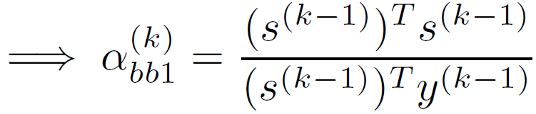
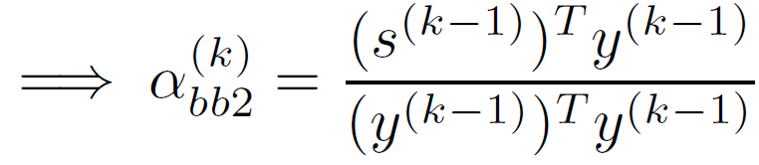
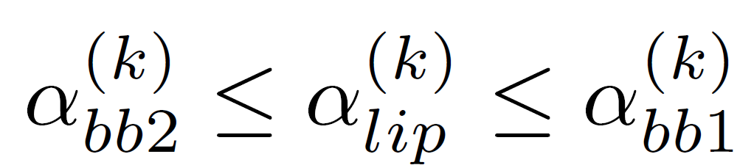
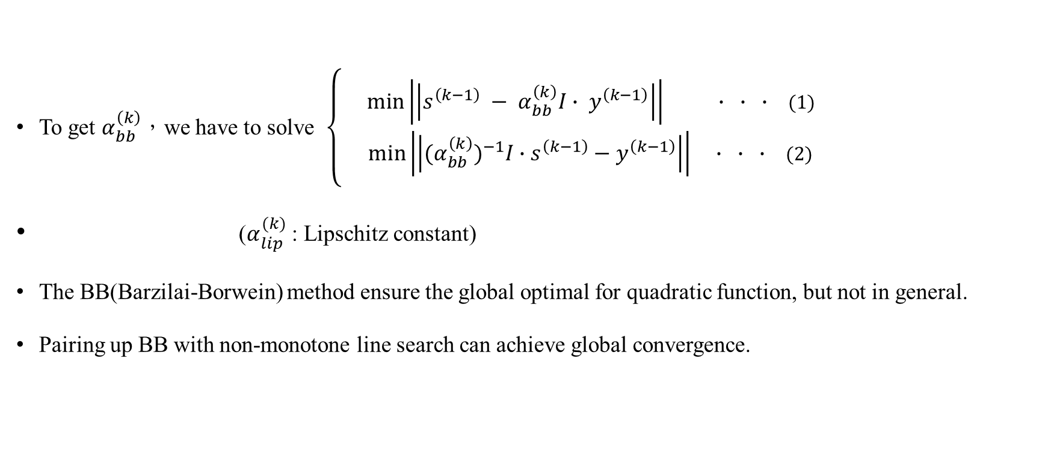
Barzilai-Borwein Method Enabled Nesterov Algorithm
To get $α_{bb}^{\left(k\right)}$，we have to solve $\left\{\begin{aligned}\min\left|\left|s^{\left(k−1\right)} − α_{bb}^{\left(k\right)}I∙ y^{\left(k−1\right)}\right|\right| ∙ ∙ ∙ \text{(1)} \\ \min\left|\left|{(α}_{bb}^{\left(k\right)})^{−1}I∙s^{\left(k−1\right)}−y^{\left(k−1\right)}\right|\right| ∙ ∙ ∙ \text{(2)}\end{aligned}\right.$
($α_{lip}^{(k)}$ : Lipschitz constant)
The BB(Barzilai-Borwein) method ensure the global optimal for quadratic function, but not in general.
Pairing up BB with non-monotone line search can achieve global convergence.
Notes:
* 因為不能保證cost function的單調遞減 (二次函數一定是單調遞減)

Slide 18
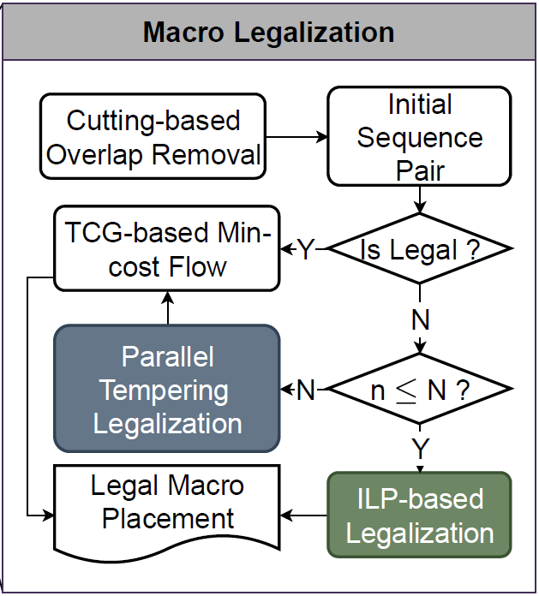
Macro legalization
First apply Cutting-based Overlap Removal to build the initial sequential pair.
If feasible:
Use transitive closure graph based min-cost flow algorithm to obtain macro positions.
If infeasible:
Small problem size: Use ILP-based macro legalization.
Large problem size: parallel tempering based macro legalization.

Slide 19
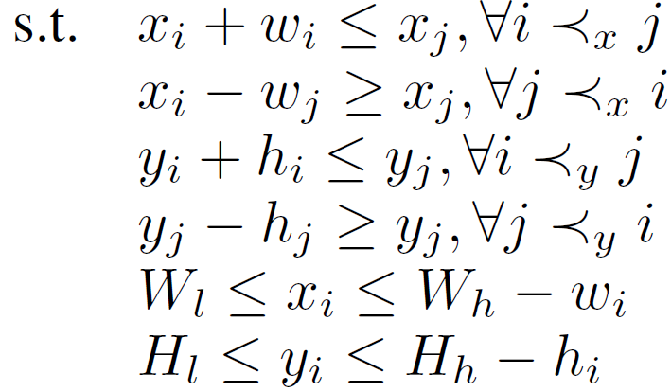


Macro Legalization
Macro legalization can be formulated as following.
($\hat{x}, \hat{y}$)$:$ The coordinates before legalization
($w_{i}, h_{i}$): The width and height of the instance i
$W_{l }(W_{h}):$ the left (right) boundary of the layout
${ H}_{l} (H_{h})$ : the bottom (top) boundary of the layout

Slide 20
Dual Min-Cost Flow based Macro Legalization
The target is to remove overlaps towards minimum displacement.
Perform transitive closure graph based constraints reduction.
Use transitive closure graph (TCG) to represent the relation between macros without redundancy

Slide 21
Thank you for listening!

